Slide 1
Weighted least squares
蒋智超
2022年 秋

Slide 2



Generalized least squares
Generalized Gauss-Markov model
Two leading cases

Slide 3

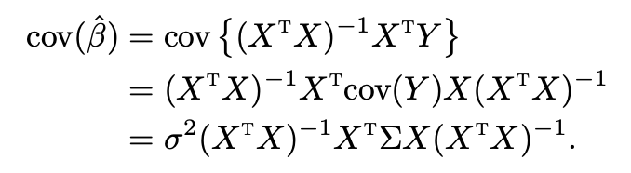
OLS estimator
We can still use the OLS estimator
It is not BLUE under the Generalized Gauss-Markov model

Slide 4

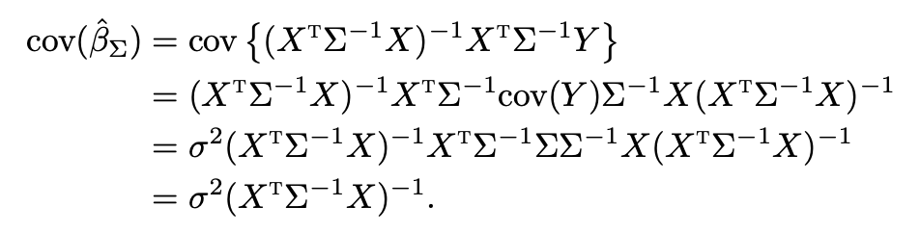
BLUE
We can transform the Generalized Gauss-Markov model into the Gauss-Markov model
The BLUE is

Slide 5

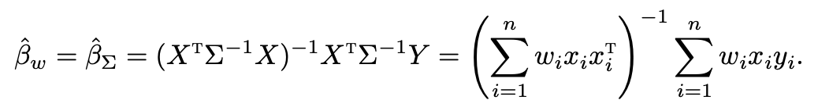
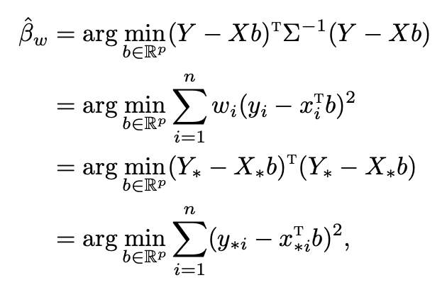

Weighted least squares
Covariance
We can also write
Notes:
WLS is equivalent to the OLS with ii
transformed variables, with the weights inversely proportional to the variances of the errors. By this equivalence, WLS inherits many properties of OLS.

Slide 6


Weighted least squares
Generalized Normal linear model
The lm function with weights reports the standard errors, t-statistics, and p values
based on this model
This assumes that the weights fully capture the heteroskedasticity, which is unrealistic
in many problems

Slide 7

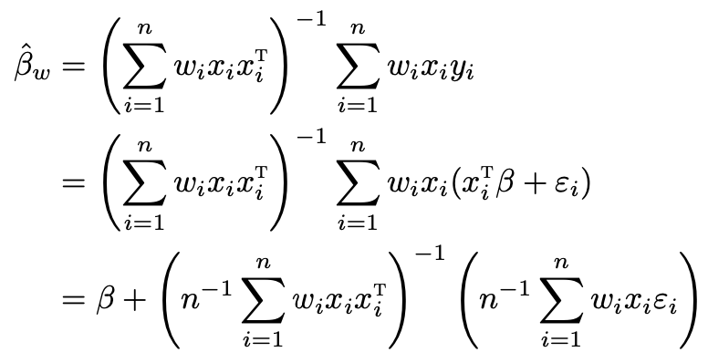
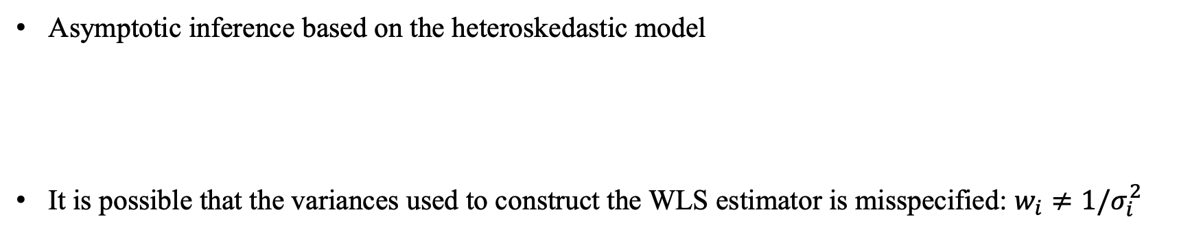
Weighted least squares
Asymptotic inference based on the heteroskedastic model
It is possible that the variances used to construct the WLS estimator is misspecified: $w_{i}≠1/σ_{i}^{2}$

Slide 8

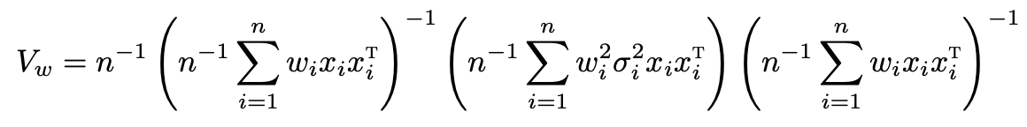
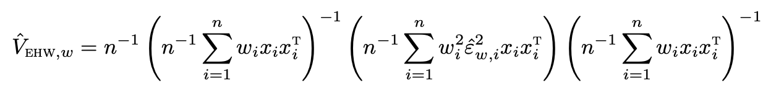

Weighted least squares
Even though there is no guarantee that ${\hat{β}}_{w}$ is BLUE, it is still unbiased
We can apply LLN to show ${\hat{β}}_{w}$ is consistent for $β$
We can apply CLT to show
The function hccm in the R package car can compute various EHW covariance estimators
based on WLS

Slide 9
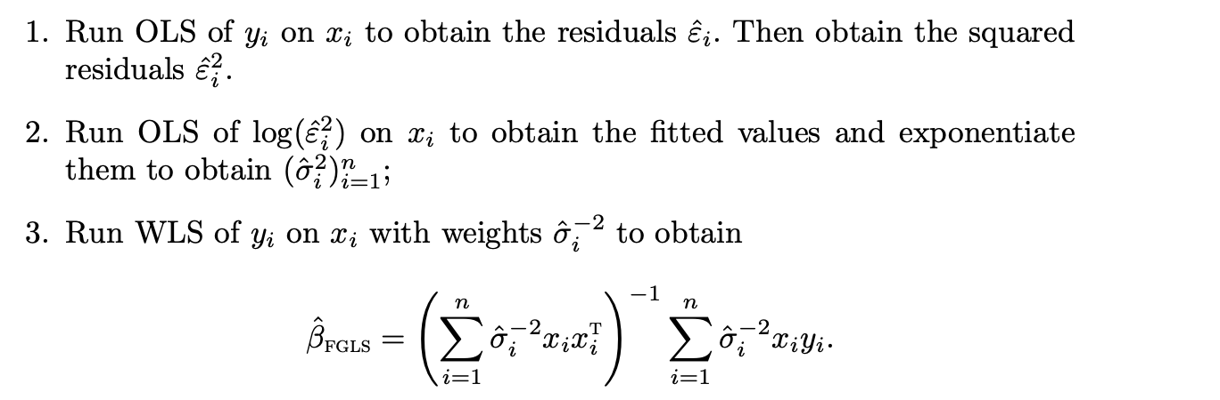
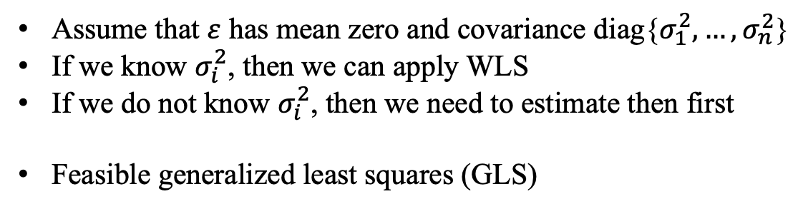
Feasible generalized least squares
Assume that $ε$ has mean zero and covariance diag{$σ_{1}^{2},…,σ_{n}^{2}$}
If we know $σ_{i}^{2}$, then we can apply WLS
If we do not know $σ_{i}^{2}$, then we need to estimate then first
Feasible generalized least squares (GLS)
Notes:
In Step 2, we can change the model based on our understanding of the heteroskedasticity.

Slide 10
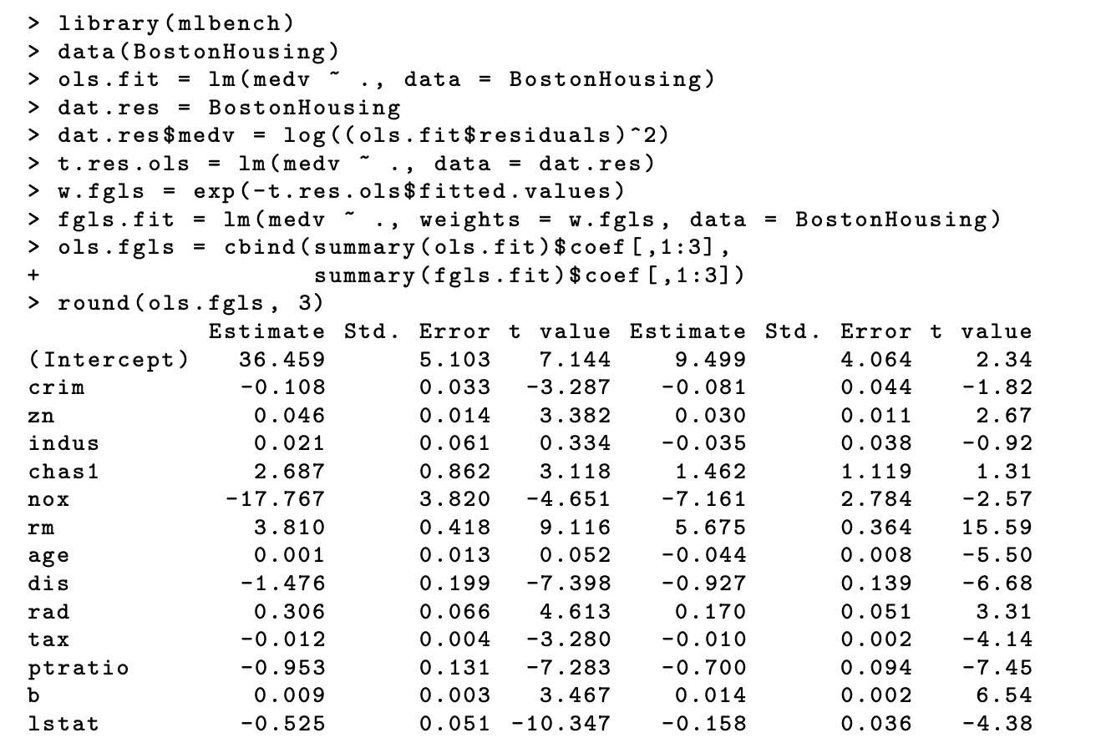
Feasible generalized least squares
Notes:
This suggests that the linear model may be misspecified.

Slide 11


Feasible generalized least squares
The above FGLS estimator is close to Wooldridge (2012)
Romano and Wolf (2017) proposes to regress on
Romano and Wolf (2017) highlighted the efficiency gain from FGLS compared to OLS in the
presence of heteroskedasticity
DiCiccio et al. (2019) proposed some improved versions of FGLS estimator even if the variance
function is misspecified
However, it is unusual for practitioners to use FGLS even though it can be more efficient than OLS
EHW standard errors are convenient for correcting the standard error of OLS
under heteroskedasticity
The efficiency gain is usually small, and it is possible that the FGLS is less efficient
The linear model is very likely to be misspecified, the OLS has the interpretations as the best
linear predictor and the best linear approximation of the conditional mean, but the FGLS has
more complicated interpretation when the linear model is wrong

Slide 12
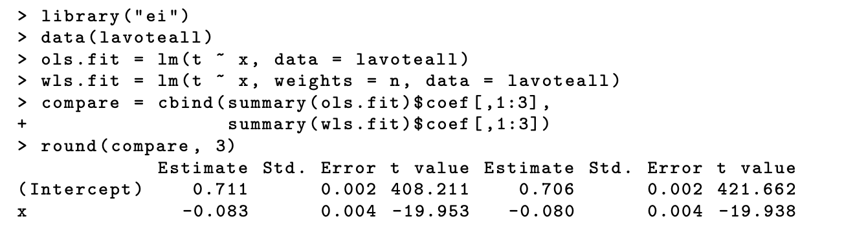
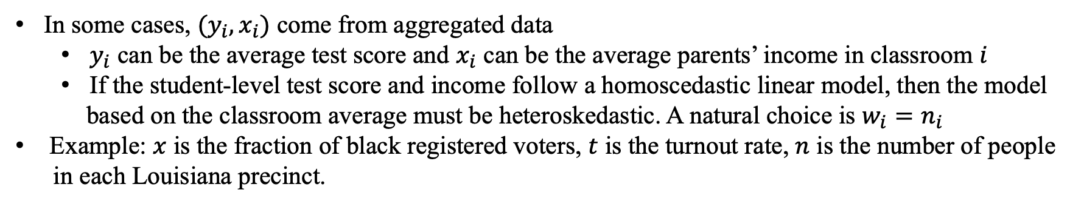
Aggregated data
In some cases, $(y_{i},x_{i})$ come from aggregated data
$y_{i}$ can be the average test score and $x_{i}$ can be the average parents’ income in classroom $i$
If the student-level test score and income follow a homoscedastic linear model, then the model
based on the classroom average must be heteroskedastic. A natural choice is $w_{i}=n_{i}$
Example: $x$ is the fraction of black registered voters, $t$ is the turnout rate, $n$ is the number of people
in each Louisiana precinct.

Slide 13


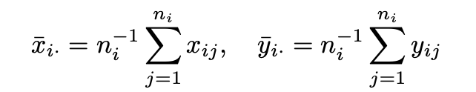
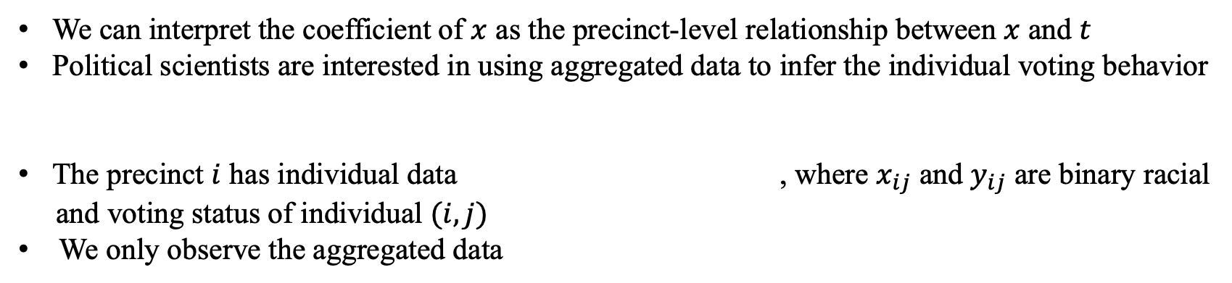
Aggregated data
We can interpret the coefficient of $x$ as the precinct-level relationship between $x$ and $t$
Political scientists are interested in using aggregated data to infer the individual voting behavior
The precinct $i$ has individual data , where $x_{ij}$ and $y_{ij}$ are binary racial
and voting status of individual $(i,j)$
We only observe the aggregated data

Slide 14

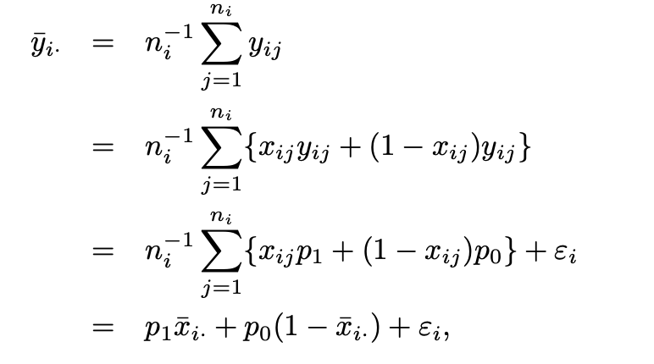
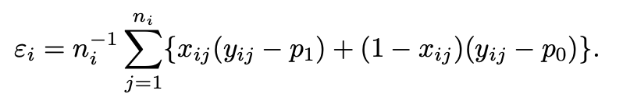
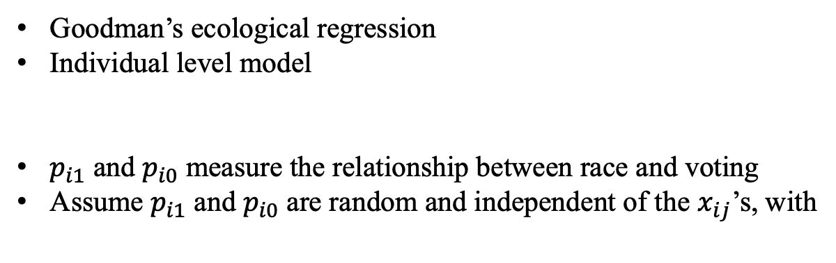
Ecological regression
Goodman’s ecological regression
Individual level model
$p_{i1}$ and $p_{i0}$ measure the relationship between race and voting
Assume $p_{i1}$ and $p_{i0}$ are random and independent of the $x_{ij}$’s, with

Slide 15



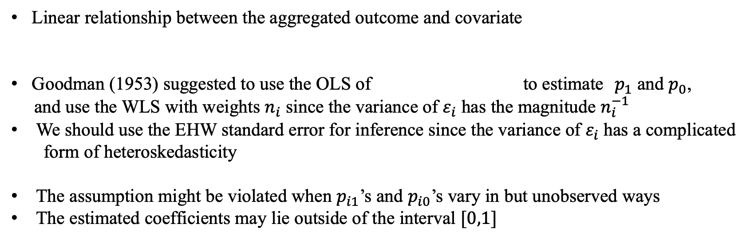
Ecological regression
Linear relationship between the aggregated outcome and covariate
Goodman (1953) suggested to use the OLS of to estimate $p_{1}$ and $p_{0}$,
and use the WLS with weights $n_{i}$ since the variance of $ε_{i}$ has the magnitude $n_{i}^{−1}$
We should use the EHW standard error for inference since the variance of $ε_{i}$ has a complicated
form of heteroskedasticity
The assumption might be violated when $p_{i1}$’s and $p_{i0}$’s vary in but unobserved ways
The estimated coefficients may lie outside of the interval $[0,1]$
Notes:
Gelman et al. (2001) gave an alternative set of assumptions justifying the ecological regression. King (1997) proposed some extensions.
Robinson (1950) warned that the ecological correlation might not inform individual correlation. Freedman et al. (1991) warned that the assumptions underlying the ecological
regression might not be plausible in practice.

Slide 16

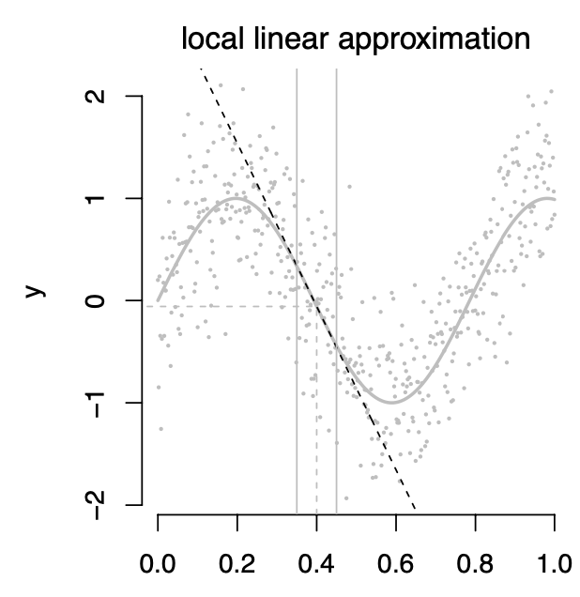
Local linear regression
Approximate any smooth function by a linear function

Slide 17
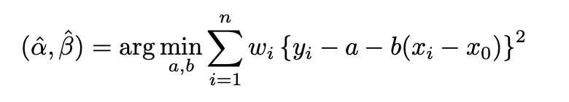

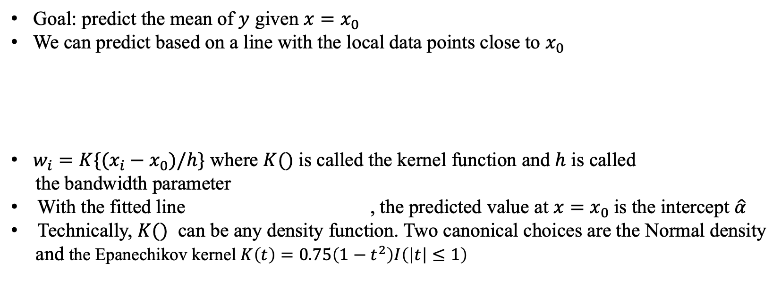
Local linear regression
Goal: predict the mean of $y$ given $x=x_{0}$
We can predict based on a line with the local data points close to $x_{0}$
$w_{i}=K\{(x_{i}−x_{0})/h\}$ where $K()$ is called the kernel function and $h$ is called
the bandwidth parameter
With the fitted line , the predicted value at $x=x_{0}$is the intercept $\hat{α}$
Technically, $K()$ can be any density function. Two canonical choices are the Normal density
and the Epanechikov kernel $K\left(t\right)=0.75\left(1−t^{2}\right)I\left(\left|t\right|≤1\right)$

Slide 18
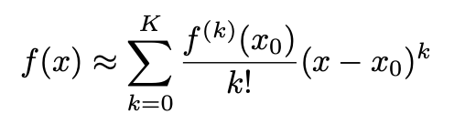
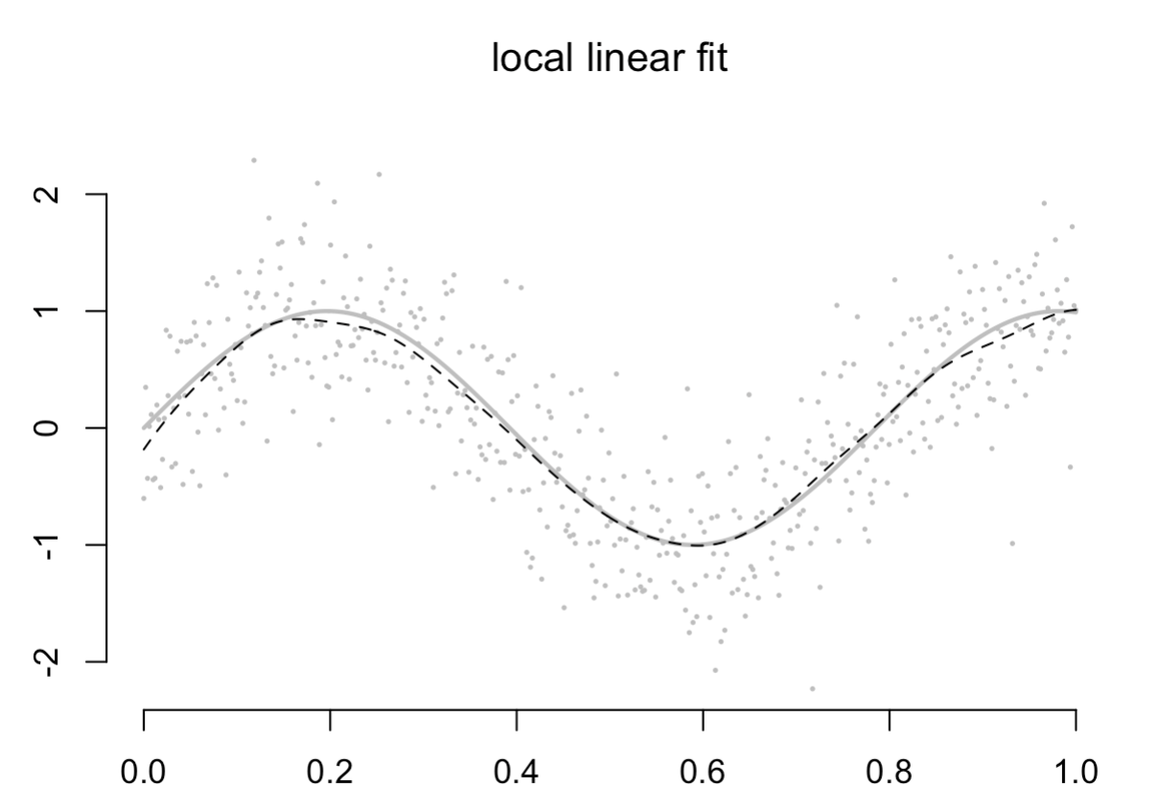
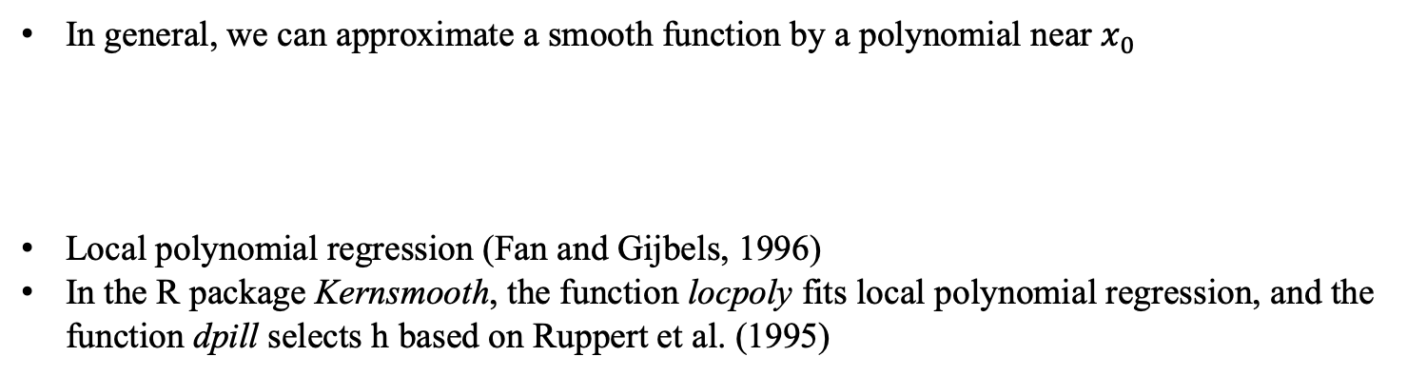
Local linear regression
In general, we can approximate a smooth function by a polynomial near $x_{0}$
Local polynomial regression (Fan and Gijbels, 1996)
In the R package Kernsmooth, the function locpoly fits local polynomial regression, and the
function dpill selects h based on Ruppert et al. (1995)

